Slide 1
Vulcan RWD FHIR IG – Supporting Visual
The following visuals have been developed to support the:
Vulcan Real World Data FHIR Implementation Guide 0.1.0
Author: Mike Hamidi

Slide 2
Final Visuals for Publication

Slide 3
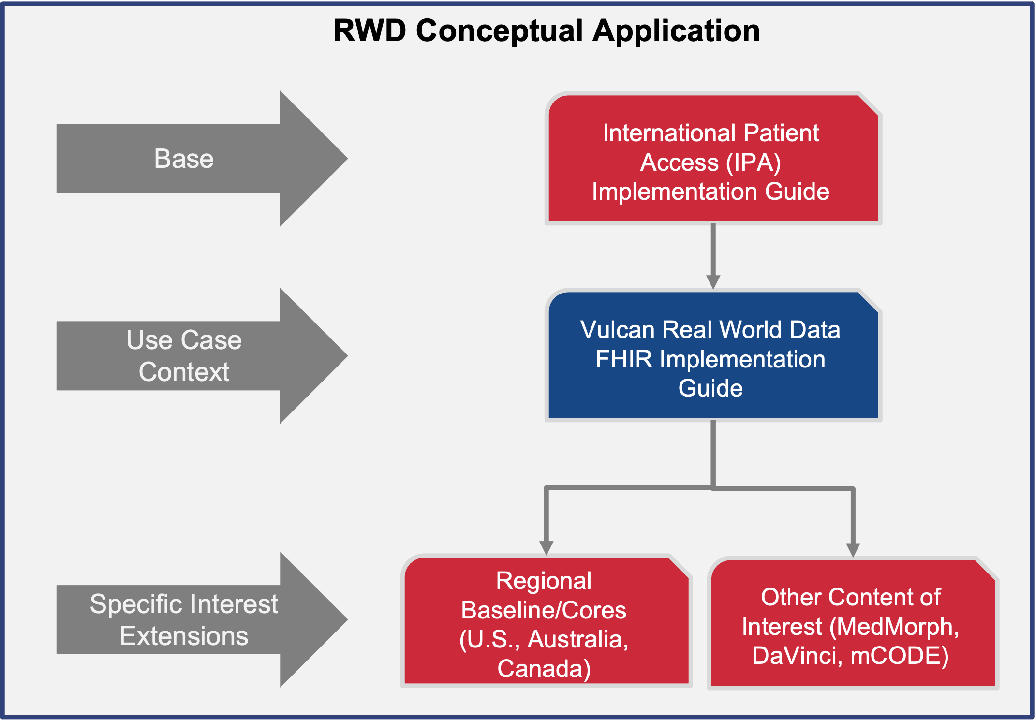
Supporting Section 1 - http://build.fhir.org/ig/HL7/vulcan-rwd/index.html

Slide 4
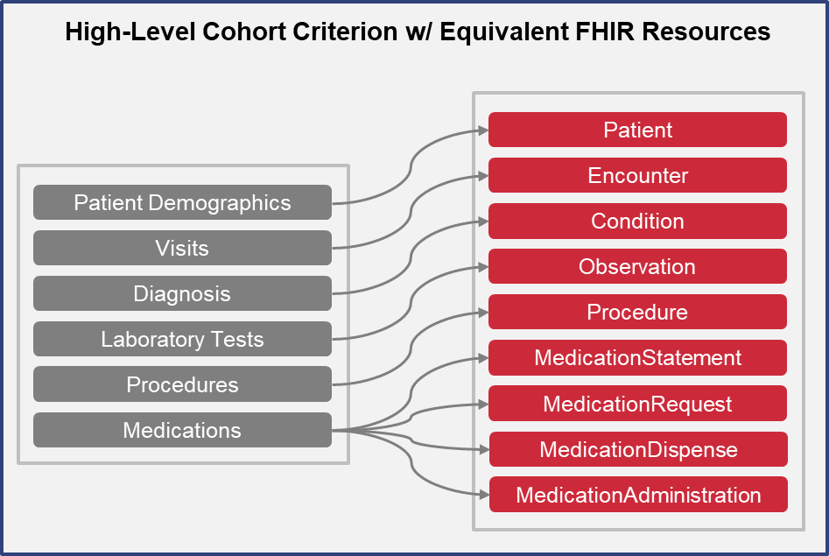
Supporting Section 2 - http://build.fhir.org/ig/HL7/vulcan-rwd/patients.htm

Slide 5
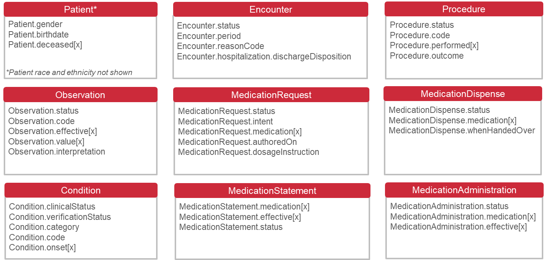
RWD FHIR IG Composition
*Additional IPS FHIR IG content can be used as applicable
Supporting Section 9 - http://build.fhir.org/ig/HL7/vulcan-rwd/acs.html

Slide 6
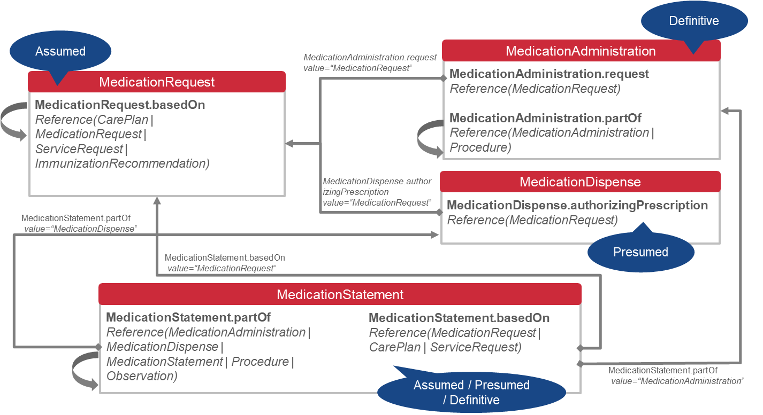
Medication Reliability: Qualitative Assessment*
*It pertains to knowing if a medication was planned to be vs. taken by the patient. There may be other resource relationships not shown.
Supporting Section 6 - http://build.fhir.org/ig/HL7/vulcan-rwd/medications.html

Slide 7
Original Source Material (Editable)

Slide 8
Vulcan RWD FHIR IG – Supporting Visual
Editable Version
RWD Conceptual Application
Base
International Patient Access (IPA) Implementation Guide
Use Case Context
Vulcan Real World Data FHIR Implementation Guide
Specific Interest Extensions
Regional Baseline/Cores
(U.S., Australia, Canada)
Other Content of Interest (MedMorph, DaVinci, mCODE)
Supporting Section 1 - http://build.fhir.org/ig/HL7/vulcan-rwd/index.html

Slide 9
Vulcan RWD FHIR IG – Supporting Visual
Editable Version
High-Level Cohort Criterion w/ Equivalent FHIR Resources
Patient
Encounter
Patient Demographics
Condition
Visits
Observation
Diagnosis
Procedure
Laboratory Tests
MedicationStatement
Procedures
MedicationRequest
Medications
MedicationDispense
MedicationAdministration
Supporting Section 2 - http://build.fhir.org/ig/HL7/vulcan-rwd/patients.htm

Slide 10
Vulcan RWD FHIR IG – Supporting Visual
Editable Version
Patient*
Encounter
Procedure
Patient.gender
Patient.birthdate
Patient.deceased[x]
Encounter.status
Encounter.period
Encounter.reasonCode
Encounter.hospitalization.dischargeDisposition
Procedure.status
Procedure.code
Procedure.performed[x]
Procedure.outcome
*Patient race and ethnicity not shown
Observation
MedicationRequest
MedicationDispense
Observation.status
Observation.code
Observation.effective[x]
Observation.value[x]
Observation.interpretation
MedicationRequest.status
MedicationRequest.intent
MedicationRequest.medication[x]
MedicationRequest.authoredOn
MedicationRequest.dosageInstruction
MedicationDispense.status MedicationDispense.medication[x]
MedicationDispense.whenHandedOver
Condition
MedicationStatement
MedicationAdministration
Condition.clinicalStatus
Condition.verificationStatus
Condition.category
Condition.code
Condition.onset[x]
MedicationStatement.medication[x]
MedicationStatement.effective[x]
MedicationStatement.status
MedicationAdministration.status
MedicationAdministration.medication[x]
MedicationAdministration.effective[x]
Supporting Section 9 - http://build.fhir.org/ig/HL7/vulcan-rwd/acs.html

Slide 11
Includes Recommended Items in Bold
Vulcan RWD FHIR IG – Supporting Visual
Editable Version
Patient*
Encounter
Procedure
Patient.gender
Patient.birthdate
Patient.deceased[x]
Encounter.status
Encounter.period
Encounter.reasonCode
Encounter.diagnosis.condition*
Encounter.hospitalization.dischargeDisposition
Procedure.status
Procedure.code
Procedure.performed[x]
Procedure.outcome
Procedure.reasonCode*
*Patient race and ethnicity not shown
Observation
MedicationRequest
MedicationDispense
Observation.status
Observation.code
Observation.effective[x]
Observation.value[x]
Observation.interpretation
Observation.method*
MedicationRequest.status
MedicationRequest.intent
MedicationRequest.medication[x]
MedicationRequest.authoredOn
MedicationRequest.dosageInstruction
MedicationDispense.status MedicationDispense.medication[x]
MedicationDispense.whenHandedOver
Condition
MedicationStatement
MedicationAdministration
Condition.clinicalStatus
Condition.verificationStatus
Condition.category
Condition.code
Condition.onset[x]
MedicationStatement.medication[x]
MedicationStatement.effective[x]
MedicationStatement.status
MedicationAdministration.status
MedicationAdministration.medication[x]
MedicationAdministration.effective[x]
Supporting Section 9 - http://build.fhir.org/ig/HL7/vulcan-rwd/acs.html
*Refer to comments concerning added items
Notes:
Questions:
Encounter – Do we need to know the details concerning the encounter (via Encounter.diagnosis.condition)?
Observation – Should Observation.method be included, or shall we assume Observation.code is sufficient?
Procedure – Do we need to know if the procedure was related to the condition itself (via Procedure.reasonCode)?
MedicationRequest – Do we need to know the reason for the medication request (via MedicationRequest.reasonCode)?
MedicationRequest – How viable is the use of instructions using MedicationRequest.dosageInstruction? For example, the timing.bounds is relative to approximations
MedicationRequest – Can it be assumed that time boxing of the request can be used via MedicationRequest.dispenseRequest.validityPeriod? In addition, the numberOfRepeatsAllowed can provide additional details on the number of refills allowed.

Slide 12
Vulcan RWD FHIR IG – Supporting Visual
Editable Version
Definitive
Assumed
MedicationAdministration.request
value=“MedicationRequest”
MedicationAdministration
MedicationRequest
MedicationAdministration.request
Reference(MedicationRequest)
MedicationAdministration.partOf Reference(MedicationAdministration | Procedure)
MedicationRequest.basedOn
Reference(CarePlan | MedicationRequest | ServiceRequest | ImmunizationRecommendation)
MedicationDispense.authorizingPrescription
value=“MedicationRequest”
MedicationDispense
MedicationDispense.authorizingPrescription
Reference(MedicationRequest)
MedicationStatement.partOf
value=“MedicationDispense”
Presumed
MedicationStatement.basedOn
value=“MedicationRequest”
MedicationStatement
MedicationStatement.partOf Reference(MedicationAdministration | MedicationDispense | MedicationStatement | Procedure | Observation)
MedicationStatement.basedOn
Reference(MedicationRequest | CarePlan | ServiceRequest)
MedicationStatement.partOf
value=“MedicationAdministration”
Assumed / Presumed / Definitive
Supporting Section 6 - http://build.fhir.org/ig/HL7/vulcan-rwd/medications.html

Slide 13
EHR Data
In-Scope of the IG
Cohort Determination
Patient Data Retrieval
Data Warehouse

